Slide 1
Week 3
Sustainable Supply Chain Management and Life Cycle Assessment
Notes:
These are the slides for Week 3 of the Corporate Sustainability Leadership Education Program online class. Our topic this week is Sustainable Supply Chain Management and Life Cycle Assessment.

Slide 2
Session Outline
What is sustainable supply chain management?
Life cycle assessment as a tool
Cradle to cradle, the circular economy, and closing the loop
Conclusion
Summary
Vocabulary Review
Readings, Websites and Videos
Assignment
Notes:
During this session, we will cover the question of what is sustainable supply chain management? We will explore life cycle assessment as a tool, and we will touch upon the concept of cradle to cradle thinking. We will conclude with the thought that sustainable supply chain management is a key tool for corporate sustainability, and that the trend now is towards cradle to cradle thinking. This conclusion will be followed by a summary of the slides, along with a vocabulary review, a list of required and supplemental readings, websites, and videos, and your assignment for this week.

Slide 3
Learning Objectives
By the end of this session, you will be able to:
Understand the concept of sustainable supply chain management
Give examples of sustainable practices at each stage of a typical product life cycle
Identify tools to assess supply chain sustainability
Identify the steps in a life cycle assessment
Understand and apply the concepts of cradle to cradle, the circular economy, and closing the loop
Notes:
By the end of this session, you will be able to:
Understand the concept of sustainable supply chain management
Give examples of sustainable practices at each stage of a typical product life cycle
Identify tools to assess supply chain sustainability
Identify the steps in a life cycle assessment
Understand and apply the concepts of cradle to cradle, the circular economy, and closing the loop

Slide 4
What is sustainable supply chain management?
comprehensively managing the environmental and social impacts of a product’s complete lifecycle (“cradle to grave”).
Extraction
Manufacturing
Distribution
Use
Disposal
Notes:
What is sustainable supply chain management?
Sustainable supply chain management means comprehensively managing the environmental and social impacts of a product’s complete lifecycle – through the process of extraction, manufacturing, distribution, use, and disposal.
This is called looking at a product from cradle to grave.

Slide 5

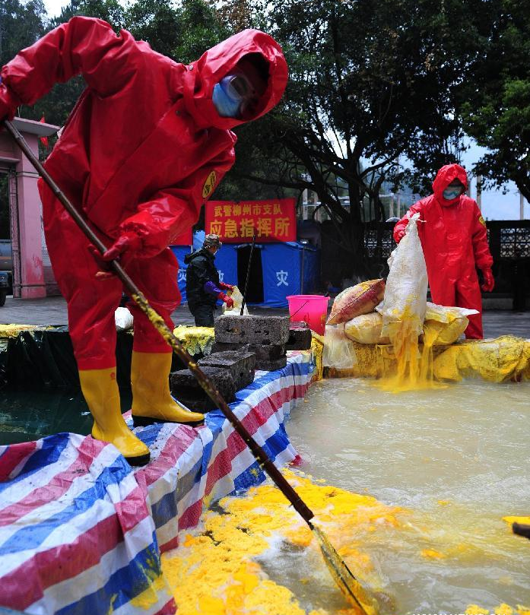
Burden-shifting
when the solution to one environmental problem creates a different environmental problem elsewhere.
Notes:
Comprehensive cradle to grave thinking avoids burden-shifting, when the solution to one environmental problem creates a different environmental problem elsewhere – or, as you could say, wen the environmental impact of a product is simply relocated.
For example: solar photovoltaic panels, shown here on the left, reduce greenhouse gas emissions by producing energy without emitting carbon dioxide – but producing the technology can result in toxic heavy metals such as cadmium being released into water sources, as is happening in the image on the right.
Image sources: http://www.reiltd.co.uk/wp-content/uploads/2015/02/solar-pv.jpg ; http://china.org.cn/photos/2012-01/31/content_24514360_4.htm

Slide 6
Supply Chain Stakeholders
Extraction
Manufacturing
Distribution
Use
Disposal
Local communities
Suppliers
Employees
Consumers
Shareholders
Society
Notes:
Sustainable supply chain management means engaging with the many stakeholders along the supply chain – shareholders, local communities, suppliers, employees, consumers, and even society at large.
Many corporations have found that working with suppliers in particular can have a greater impact than with other stakeholders. Because they supply raw materials and operate in countries with poor labor laws, suppliers often have significant environmental and social impacts.
To convince suppliers to improve their environmental and social performance, corporations can, for instance, set standards for labor and environmental goals, provide training to help its suppliers meet these goals, and then audit the suppliers’ compliance with these standards.

Slide 7
Sustainable Supply Chain Management
Step by step examples
Notes:
For supply chain management to be truly sustainable means pursuing all three parts of the Triple Bottom Line (economic, environmental, and social) at each step in a company’s supply chain.
This section goes step by step through a typical life cycle. It introduces common environmental and social concerns and gives examples of sustainable practices at each step.

Slide 8
Extraction
Extraction
Manufacturing
Distribution
Use
Disposal
Notes:
The first step is extraction.

Slide 9
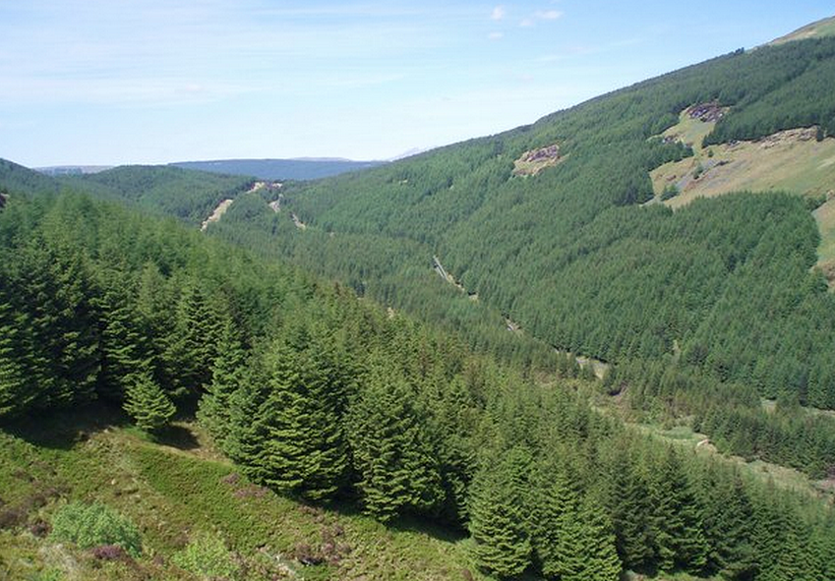
Extraction – Environmental
Deforestation
Water depletion
Pollution (air, land, water),
Biodiversity loss
Depletion of limited resources (minerals, oil and gas, coal, fish, trees)
Notes:
Because extraction usually means mining, forestry, agriculture, fishing, or drilling for oil, common environmental concerns during the extraction stage include: deforestation, water depletion, pollution of air, land, and water, biodiversity loss, and depletion of limited resource such as minerals, oil and gas, coal, fish, and trees.
Image source: http://www.walkerforestry.com/portfolio-items/sitka-spruce/

Slide 10

Extraction – Environmental
International Paper avoids deforestation by only harvesting trees from forests that are third-party certified as sustainably managed.
Notes:
One example of how a corporation has made its environmental performance more sustainable is International Paper, which avoids deforestation by only harvesting trees from forests that are third-party certified as sustainably managed – and this includes sustainably managing its paper mills in Russia.
Image source: http://www.walkerforestry.com/portfolio-items/sitka-spruce/
Reference: http://www.internationalpaper.com/planet/policies-certifications/certificates

Slide 11
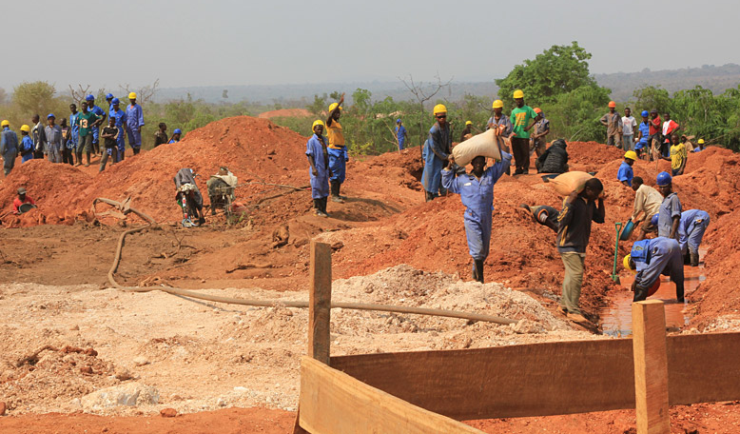
Extraction – Social
Displacement of local community
Health and safety of local community
Conflict minerals (where profit from mining funds armed conflict)
Notes:
Common social concerns during the extraction stage include: the displacement of the communities that live near mines or drilling sites, and the health and safety of these local communities. Another concern is what are called conflict minerals. Many materials used in electronics, including copper and a mineral called coltan, are mined in regions divided by civil wars– and the profits from this mining have often been used to fund the cycle of violence.
Image source: http://solutions-network.org/site-sfhtantalum/photos-gallery1

Slide 12

Extraction – Social
Motorola ensures that its central African suppliers of coltan (used in cell phones) do not include armed groups.
Notes:
In an effort to reduce this negative social impact, where mining contributes to violence, Motorola, for instance, has a program that ensures that its central African suppliers of coltan do not include armed groups.
Image source: http://solutions-network.org/site-sfhtantalum/photos-gallery1

Slide 13
Manufacturing
Extraction
Manufacturing
Distribution
Use
Disposal
Notes:
The next step in a typical product life cycle is manufacturing.

Slide 14
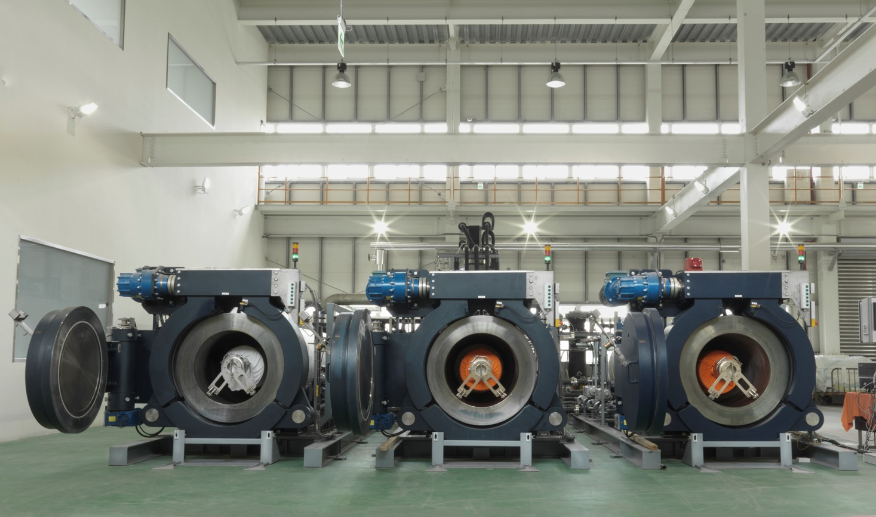
Manufacturing – Environmental
Water depletion
Pollution
Greenhouse gas emissions
Notes:
Common environmental concerns at this stage include water depletion, pollution, and greenhouse gas emissions.
Image of DyeCoo factory: http://www.dyecoo.com/dyecoo/wp-content/uploads/2015/10/Job_1768_25812.jpg

Slide 15

Manufacturing – Environmental
Nike invested in DyeCoo to help produce a waterless dyeing process, reducing the amount of water used to dye Nike textiles.
Notes:
The textile industry is one of the biggest users of water in the world. Our example here, the clothing manufacturer Nike, has invested in one of its dye suppliers, DyeCoo, to create a fabric dyeing process that does not use water. The DyeCoo factory is pictured here. This waterless process helps to reduce Nike’s overall water consumption in the manufacturing stage.
Image of DyeCoo factory: http://www.dyecoo.com/dyecoo/wp-content/uploads/2015/10/Job_1768_25812.jpg

Slide 16
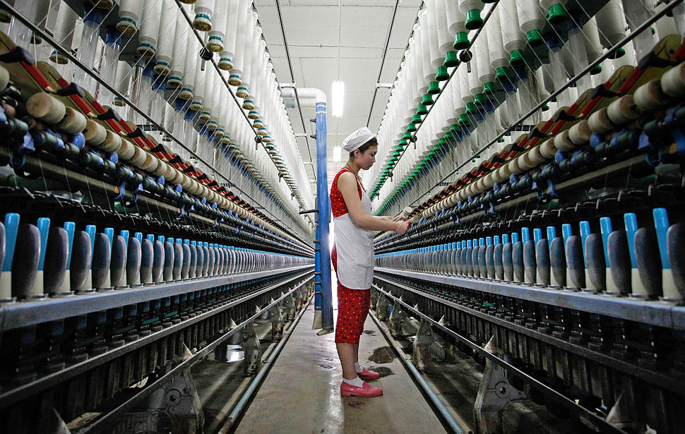
Manufacturing – Social
Worker safety
Labor rights:
Fair wages
Equal pay between men and women
Fair hours
No child labor
No forced labor
Notes:
Common social concerns during the manufacturing stage are worker safety and labor rights, which include fair wages, equal pay between men and women, fair hours – meaning no overly long workdays, no child labor, and no forced labor.
Image source: http://www.globalrecyclingideas.com/wp-content/uploads/2015/05/la-0325-pin02.jpg

Slide 17

Manufacturing – Social
Unilever’s Responsible Sourcing Policy requires all of its suppliers to follow international human rights conventions.
Notes:
One example of social sustainability at the manufacturing stage is Unilever, a major corporation that produces cosmetics and cleaning products, among other products.
Unilever’s Responsible Sourcing Policy requires all of its suppliers to follow a code that incorporates the Universal Declaration of Human Rights, the International Labor Organization’s conventions on Rights at Work, and several other international conventions on civil and economic rights.
Unilever uses a number of different auditing methods, where it monitors its suppliers’ performance on these standards, to ensure that its suppliers are acting in a socially sustainable way.
Image source: http://www.globalrecyclingideas.com/wp-content/uploads/2015/05/la-0325-pin02.jpg
Reference: https://www.unilever.com/Images/slp-unilever-responsible-sourcing-policy-2014_tcm244-409819_en.pdf ; http://www.behindthebrands.org

Slide 18
Distribution
Extraction
Manufacturing
Distribution
Use
Disposal
Notes:
The next stage in a product life cycle is distribution.

Slide 19
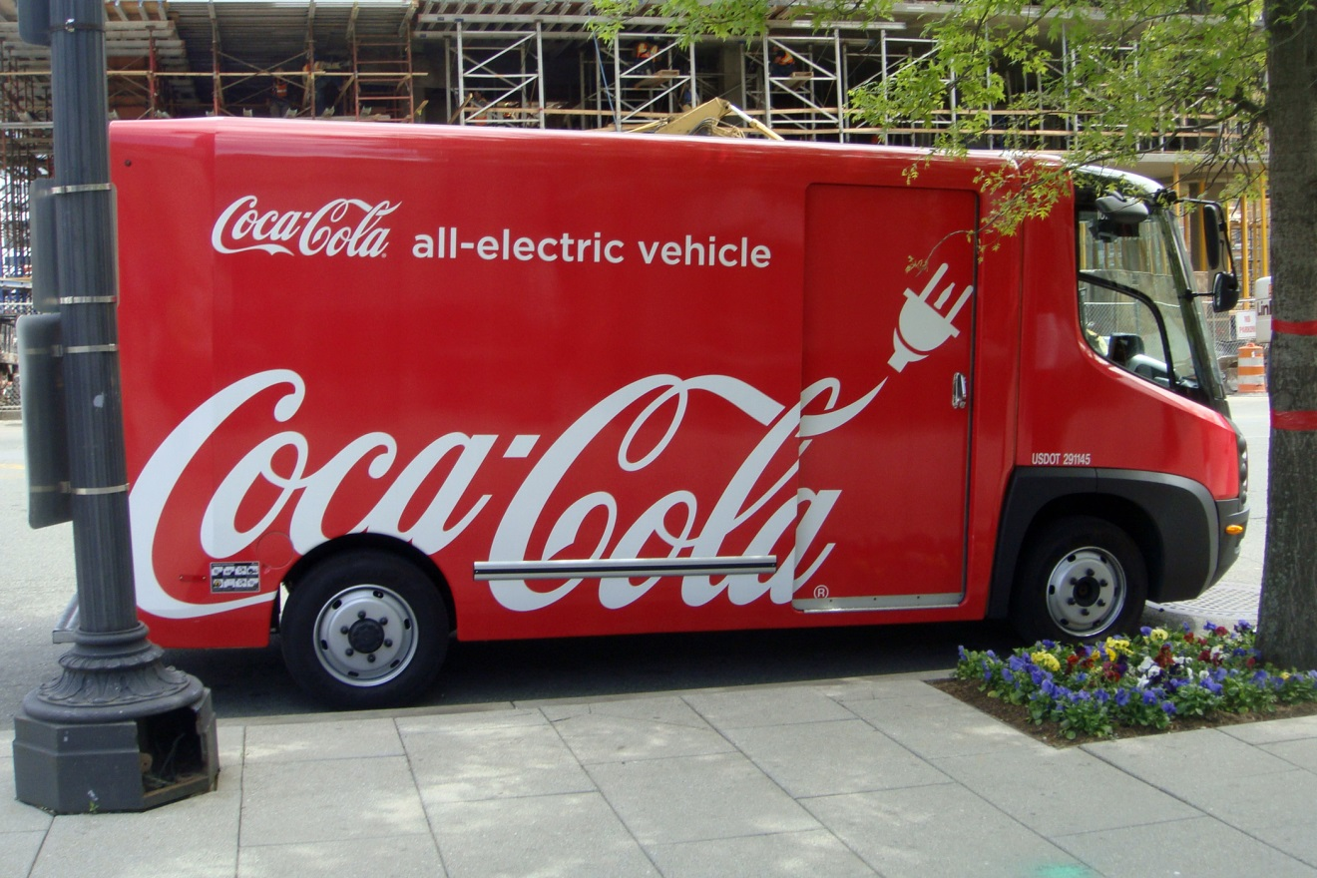
Distribution – Environmental
Greenhouse gas emissions
Packaging waste
Notes:
Common environmental concerns at this stage are mostly the greenhouse gases emitted while transporting products, as well as wasteful packaging.
Image source: https://upload.wikimedia.org/wikipedia/commons/a/a6/Coca_Cola_eStar_EV_DC_04_2012_3743.JPG

Slide 20

Distribution – Environmental
Coca Cola uses electric vehicles and recyclable bottles made out of plastic derived from sugar cane.
Notes:
In an effort to reduce these environmental impacts, Coca Cola uses electric vehicles in its fleet and has rolled out a recyclable bottle made out of plastic derived from sugar cane.
Image source: https://upload.wikimedia.org/wikipedia/commons/a/a6/Coca_Cola_eStar_EV_DC_04_2012_3743.JPG
References: http://money.cnn.com/2015/06/04/technology/coke-plastic-plant-bottle/ ; https://www.greenbiz.com/news/2012/10/10/catch-behind-coca-colas-switch-plant-based-bottles; http://www.coca-colacompany.com/stories/a-frigid-fleet-coca-cola-unveils-first-electric-refrigerated-trucks

Slide 21
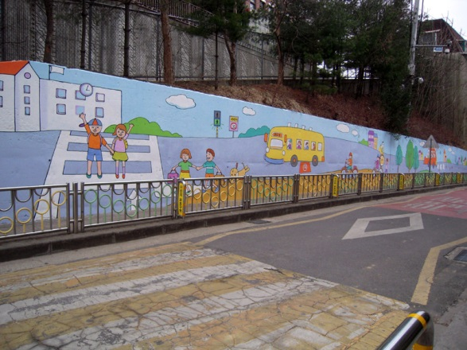
Distribution – Social
Health and safety of surrounding communities (especially along pipelines, highways, or major train lines)
Notes:
Common social concerns during the distribution stage are the health and safety of surrounding communities. This is especially for communities located along pipelines, major train lines, or roadways with high levels of traffic – all the areas where accidents are more likely.
Image source: http://www.safekids.org/koreas-model-school-zone-project

Slide 22

Distribution – Social
FedEx funds pedestrian-friendly infrastructure near schools in Brazil, China, India, the US, China, and several other countries.
Notes:
An example of social sustainability here is FedEx, which is one of the major forces in global product distribution. FedEx funds a road safety program that builds pedestrian-friendly infrastructure near schools in Brazil, China, India, the US, and several other countries. This means that the roads near schools are safer for children and their parents as they go to and from school.
Image source: http://www.safekids.org/koreas-model-school-zone-project
Reference: http://www.safekids.org/walk-way

Slide 23
Use
Extraction
Manufacturing
Distribution
Use
Disposal
Notes:
The next stage is the use stage.

Slide 24
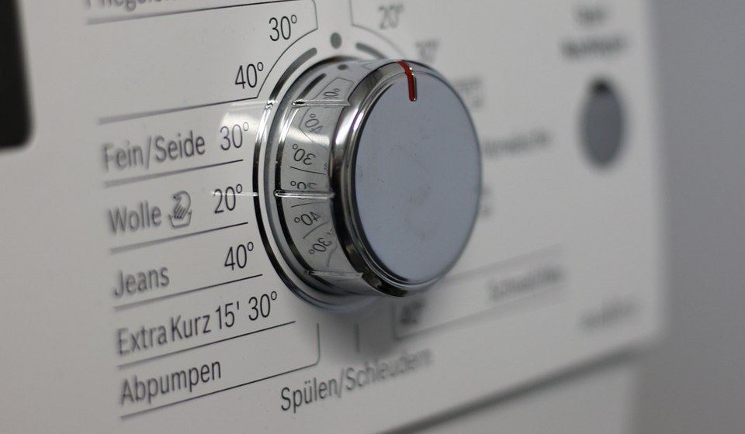
Use – Environmental
Greenhouse gas emissions
Water depletion
Notes:
Common environmental impacts during use for consumer goods such as appliances, cars, or electronics are greenhouse gas emissions and water depletion.
Image source: https://pixabay.com/p-1033640

Slide 25
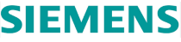
Use – Environmental
Siemens has designed washing machines that are more energy- and water-efficient.
Notes:
One example of how a corporation has reduced the environmental impacts of its consumer goods during use is Siemens, which has designed washing machines that are more energy- and water-efficient.
Image source: https://pixabay.com/p-1033640
Reference: https://www.bsh-group.com/presse/fileadmin/publication/Englisch/BSH_Sustainability-Report_2011_english.pdf

Slide 26
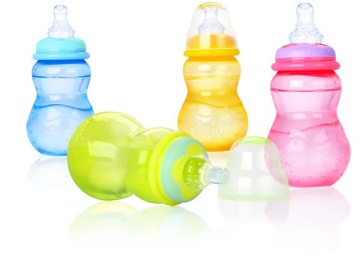
Use – Social
Health, safety, and privacy of the consumer
Notes:
Common social concerns during the use phase are the health, safety, and privacy of the consumer.
Image source: https://c1.staticflickr.com/3/2197/2423199243_647afcfa1e.jpg

Slide 27
Use – Social
Several major manufacturers have removed Bisphenol A – a potentially harmful chemical – from food packaging and baby bottles.
Notes:
One example here of social sustainability during the use stage is Bisphenol A, or BPA. There is some evidence that BPA lining in food packaging or baby bottles has potentially harmful effects on the health of consumers. This led several major manufacturers – including Nestle, Heinz, and the baby bottle manufacturers Playtex and Avent – to remove BPA from their products in order to protect their consumers’ health.
Image source: https://c1.staticflickr.com/3/2197/2423199243_647afcfa1e.jpg
References: http://archive.fortune.com/2008/07/15/magazines/fortune/gunther_bpa.fortune/index.htm ; http://www.independent.co.uk/life-style/health-and-families/health-news/major-producers-to-ditch-bpa-from-packaging-2121837.html

Slide 28
Disposal
Extraction
Manufacturing
Distribution
Use
Disposal
Notes:
The last stage of a life cycle is disposal.

Slide 29
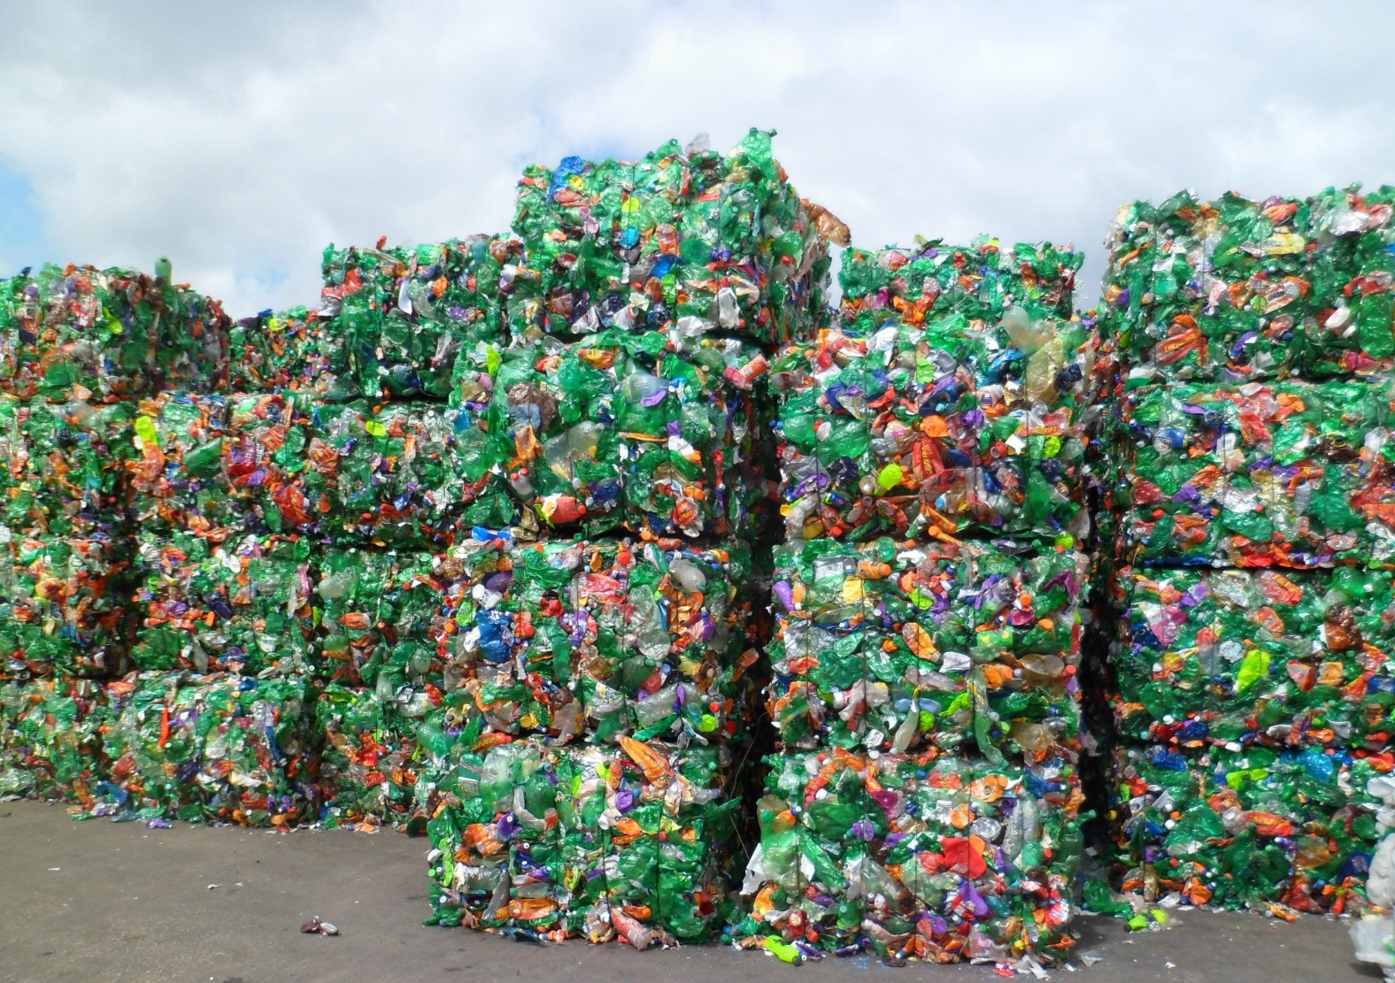
Disposal – Environmental
Pollution
Land use
Notes:
Common environmental concerns with disposal include pollution, along with land use – disposal sites take up space in the landscape, and land that is used for landfills cannot be used for anything else.
Image source: https://upload.wikimedia.org/wikipedia/en/6/63/Bales_Crushed_PET_Bottles.JPG

Slide 30

Disposal – Environmental
Instead of discarding plastic waste, Walmart sells it to packaging suppliers.
Notes:
One example of improved environmental performance in the disposal stage is Walmart, which now turns its plastics waste into pellets and sells those plastics to packaging suppliers, which then recycle the plastics into new packaging.
Image source: https://upload.wikimedia.org/wikipedia/en/6/63/Bales_Crushed_PET_Bottles.JPG
Reference: http://knowledge.wharton.upenn.edu/special-report/greening-the-supply-chain-best-practices-and-future-trends/

Slide 31
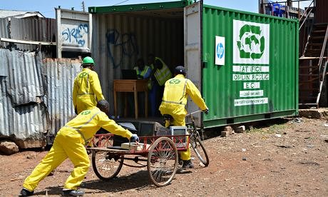
Disposal – Social
Health of the local community
Notes:
The main social concern in the disposal stage is the health of the community living near disposal sites. One major instance of this worldwide is electronic waste or e-waste. People in many poor areas around the world burn e-waste to recover the metals used in electronics. Burning these electronics pollutes the water, ground, and air.
Image source: Hewlett-Packard (https://www.theguardian.com/sustainable-business/sustainability-case-studies-hewlett-packard-ewaste-recycling-africa)

Slide 32

Disposal – Social
Hewlett Packard is eliminating chemicals from its power cables . It also recycles e-waste globally.
Notes:
One partial solution to this problem comes from the electronics manufacturer Hewlett Packard, which is trying to eliminate PVC, a chemical that is toxic when it is burned, from the power cables that HP produces. In the image here, we can see one of HP’s programs to recycle and refurbish, or rebuild, electronic waste, so that electronics get repaired and reused rather than burned.
Image source: Hewlett-Packard (https://www.theguardian.com/sustainable-business/sustainability-case-studies-hewlett-packard-ewaste-recycling-africa)

Slide 33
Sustainable Supply Chain Mgmt.
Extraction
Manufacturing
Distribution
Use
Disposal
Deforestation
Water depletion
Pollution (air, land, water),
Biodiversity loss
Depletion of limited resources (minerals, oil, fish, trees)
Water depletion
Pollution
Greenhouse gas emissions
Greenhouse gas emissions
Packaging waste
Greenhouse gas emissions
Water depletion
Pollution
Land use
Displacement of local community
Health and safety of local community
Conflict minerals (where profit from mining funds armed conflict)
Worker safety
Labor rights (Fair wages, equal pay between men and women, fair hours, no child labor, no forced labor)
Health and safety of surrounding communities (especially along pipelines, highways, or major train lines)
Health, safety, and privacy of the consumer
Health of the local community
Notes:
These are the stages in a product life cycle. At every stage, there are common potential environmental impacts – shown in green here – and common social impacts – show in blue here.
A product’s life cycle is a complex system, with many potential trade-offs but many potential opportunities. How can corporate leaders make decisions about where to improve?
One tool to help leaders make these decisions is life cycle assessment, which we will talk about next.

Slide 34
Life Cycle Assessment
A tool for sustainable supply chain management
Notes:
Life cycle assessment is a tool for sustainable supply chain management.

Slide 35


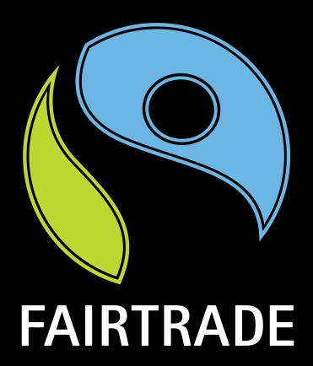
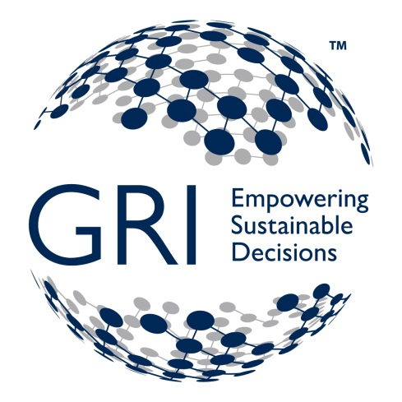


Tools to Assess Supply Chains
Notes:
Life cycle assessment is one type of tool among many. There are dozens of tools for assessing various aspects of sustainability throughout the supply chain. Several examples are shown here.
There are eco-labels, such as the Marine Stewardship Council for sustainably caught fish and the Forest Stewardship Council for sustainably managed forests. There are also fair trade labels, which certify that suppliers and workers receive fair wages for their work.
There are also specific methods for calculating environmental impacts. Companies can calculate their water footprint. One increasingly important tool is the greenhouse gas protocol, which calculates the greenhouse gasses emitted across a product’s life cycle. This will be covered in more detail in later weeks. There is also the Global Reporting Initiative, which attempts to measure a company’s comprehensive sustainability. There will be more on this in later weeks as well.

Slide 36
Life Cycle Assessment (LCA)
ISO 14040 and ISO 14044 are international standards that defines the LCA process:
Goal and scope definition
What is the purpose of the LCA?
Inventory analysis
Interpretation
Impact assessment
What are the boundaries?
What potential environmental impacts might the inputs and outputs have?
What are the inputs and outputs for the product?
Based on the findings of steps 2 and 3, what should the company do about the impacts?
Notes:
Unlike these specific tools, life cycle assessment is not a method for calculating, but a standard process of asking and answering certain questions.
In fact, life cycle assessment is defined by the international standards ISO fourteen oh four oh and ISO fourteen oh four four.
These international standards define a standard process – one which this week’s intro video walks through with the example of an automobile. The steps include:
First is goal and scope definition, where you ask: what is the purpose of the life cycle assessment? What are the boundaries of a product’s life cycle?
Second is inventory analysis, where you ask: what are the inputs and outputs of the product?
Third is impact assessment, where you ask: what environmental impacts do the inputs, outputs, and process all have?
And last is interpretation, where you ask: what can the company do about the impacts?

Slide 37
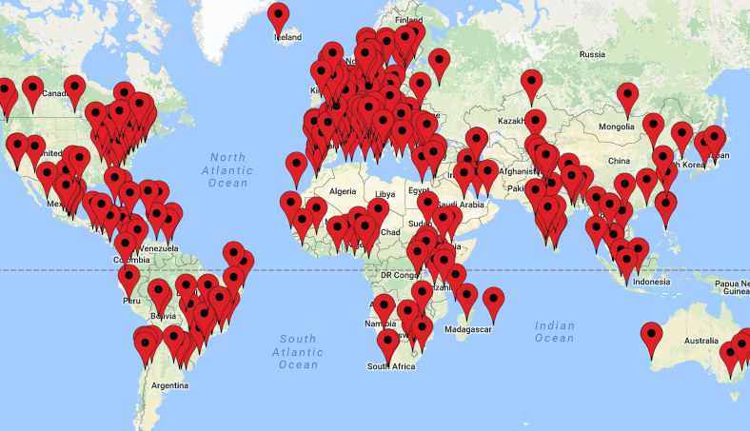
Who Uses LCA?
Life Cycle Initiative Community Map
Notes:
Who uses LCA?
LCA is a widely used tool, in all sectors, in all regions. As an example of the reach of life cycle thinking: this image is the Life Cycle Initiative Community Map – it shows the locations of the nearly 3000 members of the Life Cycle Initiative Community, a network of corporations, non-profits, and research institutions that are working to implement life cycle thinking.
That said, major transnational corporations tend to be in the forefront of LCA use. This is likely because they have global supply chains as well as major reputations to protect. They also have the resources to perform LCAs. Transnational corporations who have done LCAs include Tetra Pak, 3M, Nokia, Patagonia, Danone, Unilever, Ford, the Brazilian cosmetics company Natura, and many others.
References: http://www.lifecycleinitiative.org/tag/lct-illustration/

Slide 38
Social Life Cycle Assessment
Extraction
Manufacturing
Distribution
Use
Disposal
Deforestation
Water depletion
Pollution (air, land, water),
Biodiversity loss
Depletion of limited resources (minerals, oil, fish, trees)
Water depletion
Pollution
Greenhouse gas emissions
Greenhouse gas emissions
Packaging waste
Greenhouse gas emissions
Water depletion
Pollution
Land use
Displacement of local community
Health and safety of local community
Conflict minerals (where profit from mining funds armed conflict)
Worker safety
Labor rights (Fair wages, equal pay between men and women, fair hours, no child labor, no forced labor)
Health and safety of surrounding communities (especially along pipelines, highways, or major train lines)
Health, safety, and privacy of the consumer
Health of the local community
Notes:
Life cycle assessments, as defined in the international standards ISO fourteen oh four oh and ISO fourteen oh four four, are designed to assess environmental impacts only – seen here in green – and not to include social concerns, seen here in blue.

Slide 39
Social Life Cycle Assessment
Extraction
Manufacturing
Distribution
Use
Disposal
Deforestation
Water depletion
Pollution (air, land, water),
Biodiversity loss
Depletion of limited resources (minerals, oil, fish, trees)
Water depletion
Pollution
Greenhouse gas emissions
Greenhouse gas emissions
Packaging waste
Greenhouse gas emissions
Water depletion
Pollution
Land use
Life Cycle Assessment
Displacement of local community
Health and safety of local community
Conflict minerals (where profit from mining funds armed conflict)
Worker safety
Labor rights (Fair wages, equal pay between men and women, fair hours, no child labor, no forced labor)
Health and safety of surrounding communities (especially along pipelines, highways, or major train lines)
Health, safety, and privacy of the consumer
Health of the local community
Social Life Cycle Assessment
Notes:
The Social life cycle assessment, or S-LCA, is a similar process to track a company’s social performance.
It is not as frequently used as the LCA, and is not subject to international standards, but it is becoming more widespread.

Slide 40

Benefits of an LCA
→ More accurately measure the materials and energy used by a product from cradle to grave
→ Make better decisions about a product’s environmental impact
→ Improve the company’s Triple Bottom Line
Notes:
Why do an LCA?
LCAs are a way to more accurately measure, track, audit the materials and energy used by a product from cradle to grave.
The transparency that results from an LCA allows companies to make better decisions about how to improve a product’s environmental impact
And this, in turn, improves the company’s Triple Bottom Line.

Slide 41
Cradle to Cradle
Closing the loop
Notes:
This last section introduces the concepts of cradle to cradle, the circular economy, and closing the loop.

Slide 42
Cradle to Grave
Extraction
Manufacturing
Distribution
Use
Disposal
Notes:
We have talked so far mostly about product lifecycles from cradle (that is, extraction) to grave (that is, disposal).

Slide 43
Cradle to Cradle
Extraction
Manufacturing
Distribution
Use
Reclamation
Disposal
No raw materials used
No resource depletion
No waste in a landfill
Notes:
But increasingly, sustainability experts seek to transform supply chains and even entire economies to what can be called “cradle to cradle.”
As you can see here, the ideal is to have a product that goes from manufacturing to distribution to use – and then its materials are reused through a process of reclamation. Those materials are used for the next cycle of manufacturing.
It uses no raw materials – and so there is no extraction stage, and no resource depletion.
The ideal is also to have a product that produces no waste – so there is no disposal stage, and no waste in landfills.

Slide 44

“Waste Equals Food”
All waste has the potential to be used to create something new
Notes:
The term cradle to cradle comes from a 2002 book called cradle to cradle, and the idea behind it is that “Waste Equals Food” – that all waste has the potential to be used to create something new.
One example they give in the book is a cherry. When a cherry rots on the ground, it is not wasted – it has the potential to grow into a new tree.
Image source: https://twitter.com/wastequalsfood

Slide 45

Cradle to Cradle: Key Concepts
Cradle to cradle thinking: Treating waste as potentially useful in creating something new.
Circular economy: Economic system where resources are used for as long as possible and then recovered or reused rather than discarded.
Closing the loop: Redesigning a process or supply chain to completely repurpose, recycle, or compost all materials.
Notes:
There are, in fact, three different terms that describe basically the same idea of a circular system.
“Cradle to cradle,” “circular economy” and “closed loop” are often used synonymously to talk about the same idea.
Cradle to cradle usually refers to the philosophy or mindset of waste being potentially useful.
The term circular economy usually refers to an entire economic system where resources are used for as long as possible and then recovered or reused rather than discarded.
And closing the loop usually refers to redesigning a process or supply chain to completely repurpose, recycle, or compost all materials.

Slide 46

The Circular Economy
Re-thinking Progress: The Circular Economy
Ellen MacArthur Foundation
Notes:
Here is one of this week’s required videos, which talks you through the concept of the circular economy. You may want to watch the video now, before continuing with the slides.

Slide 47
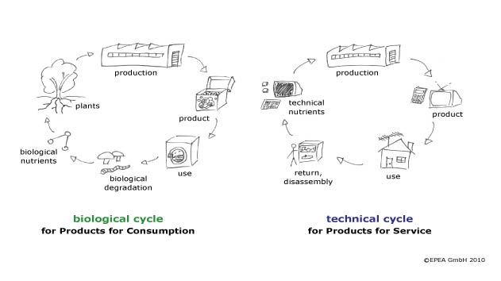
The Circular Economy
Notes:
As the video describes, one aspect of the circular economy, or cradle to cradle thinking, is that there are ideally two different closed loops. One is for natural materials, which can decompose after use and return to nature without polluting nature. One is for materials like metals or plastics which do not decompose, but can be reused again and again.
Image source: http://www.sustainablebrands.com/news_and_views/waste_not/innovative-solutions-cradle-cradle-and-beyond

Slide 48
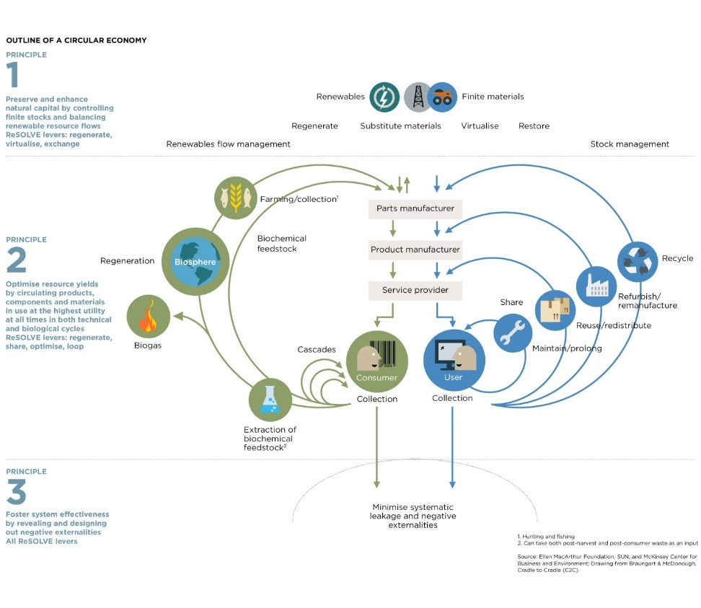
The Circular Economy
for a larger and interactive version of the diagram, see the Ellen MacArthur Foundation’s website on the circular economy
Notes:
Here is another way of looking at these two closed loops. Please feel free to click on the image – it will take you to a larger and interactive version of the image. This diagram is one of your required readings for this week.
As you look at the diagram, notice that another aspect of the circular economy is that instead of selling products, companies “share” or, that is, rent products to consumers. This allows them to take back those products when the consumer is done with them, so the consumer does not throw them away. The company then can maintain, that is, repair the product, or reuse it. As a last resort, the product can be recycled for parts.
Image source: https://www.ellenmacarthurfoundation.org/circular-economy/interactive-diagram

Slide 49
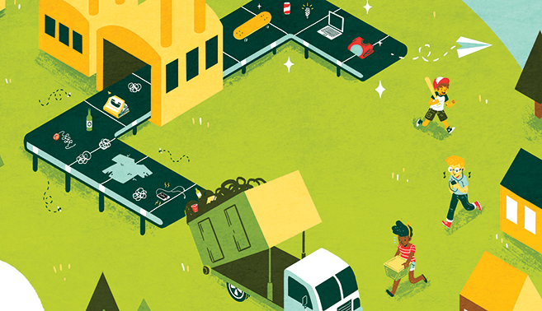
Who is Closing the Loop?
Entrepreneurs like Rubicon Global sort waste streams to recover value from materials that would otherwise be discarded.
Major manufacturers like Philips rent and repair products rather than selling them.
Countries like Japan have zero waste goals and recycling regulations to ensure reuse of materials.
Notes:
So who is “closing the loop?” What are some examples of companies or countries who have tried reducing their waste and consumption of raw materials?
Some small-scale entrepreneurs like Rubicon Global or Cirkle go through other companies’ waste streams to sort out any materials that might still be valuable.
Several major manufacturers like Philips rent and repair products rather than selling them. Philips takes back light bulbs. H&M takes back clothes. Vodaphone takes back mobile phones.
And some countries have zero waste goals and recycling regulations to ensure reuse of materials. Japan in particular has been a leader on zero waste policies for many years. Since it has a large population but little land and few natural resources, in 2000 the government passed regulations requiring manufacturers to take back products at the end of their life cycle and recover the materials. Japan now recycles 98% of its plastic, and only 5% of all waste ends in the ground. In the supplemental videos for this week, you can find a video that tours the city of Kamikatsu, which is close to achieving zero waste.
Image source: Ann Macarayan/Ensia http://ensia.com/features/zero-waste-world/
References: http://reports.weforum.org/toward-the-circular-economy-accelerating-the-scale-up-across-global-supply-chains/how-it-works-up-close-case-examples-of-circular-products/#view/fn-19; https://www.theguardian.com/sustainable-business/veolia-partner-zone/2014/nov/27/the-circular-economy-debate-examples-of-good-practice-in-business
http://reports.weforum.org/toward-the-circular-economy-accelerating-the-scale-up-across-global-supply-chains/favourable-alignment-of-enablers; https://www.the-ies.org/analysis/circular-economy-japan; http://www.env.go.jp/en/recycle/smcs/a-rep/2010gs_full.pdf

Slide 50
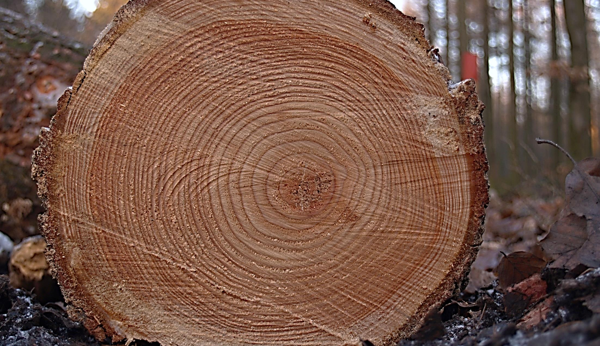
Conclusion
Notes:
To conclude our session, let’s recall that sustainable supply chain management means taking into account all environmental and social impacts of a product along that product’s entire life cycle, from “cradle to grave.”
Life Cycle Assessment is a tool that allows companies to manage their supply chains more sustainably, by asking what a product’s inputs and outputs are, and what environmental and social impacts those inputs and outputs have.
There are many ways to manage a supply chain more sustainably from cradle to grave, and these are important to recognize. But increasingly, corporate sustainability goals are aimed at designing products with a “cradle to cradle” mindset, so that no natural resources are depleted and no waste is created. This is the real leap to long-term sustainability.
Image source: https://upload.wikimedia.org/wikipedia/commons/4/42/Tree_rings.jpg

Slide 51
Summary
What is sustainable supply chain management?
Life cycle assessment as a tool
Cradle to cradle, the circular economy, and closing the loop
Conclusion
Summary
Vocabulary Review
Required Materials
Supplemental Materials
Assignment
References
Image Credits
Notes:
This week covered a great deal of material. First we asked and answered the question, what is sustainable supply chain management?
Then we explored life cycle assessment as a tool for sustainable supply chain management.
Lastly, we discussed the concept of cradle to cradle, the circular economy, and closing the loop.

Slide 52
Vocabulary Review
Sustainable supply chain management: Comprehensively managing the environmental and social impacts of a product’s complete life cycle
Cradle to grave: A product’s complete life cycle from extraction of raw materials to disposal
Burden-shifting: When the solution to one environmental problem creates a different environmental problem elsewhere
Life cycle assessment: Widely accepted method to evaluate the environmental impacts of a product’s complete life cycle
Social life cycle assessment: Increasingly accepted method to evaluate the social impacts of a product’s complete life cycle
Cradle to cradle thinking: Treating waste as potentially useful in creating something new
Circular economy: Economic system where resources are used for as long as possible and then recovered or reused rather than discarded
Closed loop: A closed-loop system produces no waste, instead completely reusing, recycling, or composting all materials

Slide 53
Required Materials
Videos:
Sustainable Supply Chain Management and Life Cycle Assessment, Dr. Kate Reese. Available on the course website.
Re-Thinking Progress: The Circular Economy, Ellen MacArthur Foundation, 28 Aug. 2011.
Sustainability at Unilever, Unilever, 30 Aug. 2011.
Readings:
Greening Global Supply Chains (pages 5-11), The Sustainability Consortium, 25 Apr. 2016. Please note that only pages 5-11 are required.
Circular Economy System Diagram, Ellen MacArthur Foundation.

Slide 54
Supplemental References
Videos
The Story of Stuff, Story of Stuff Project, 22 Apr. 2009.
How This Town Produces No Trash, Seeker Stories, 8 Dec. 2015.
Readings
“Sustainability through the Value Chain,” Diana Wilkinson, Strategic Sustainability Consulting, Mar. 2013.
“Dividing and Conquering the Trash,” David Zax, New York Times, Oct. 25, 2014.
Using the material choking Russian lakes for sustainable water technologies, Bernie Bulkin, The Guardian, 3 Jul. 2014.
The journey towards more sustainable rubber leads to Russian dandelions, Hannah Gould, The Guardian, 6 Nov. 2015.

Slide 55
Assignment
Over the course of two days, make a note of the items you throw in the garbage.
Answer the following questions, using examples from your own garbage.
Are there any items that might be composted and returned to the biosphere? (Examples might include food waste, clothing, or paper products.)
Are there any items which, instead of selling products to end consumers, companies could rent out to consumers and then collect and repair when broken? (Examples might include electronics or textiles.)
Are there any items that could be returned to the company, cleaned or modified, and reused in their current form? (Examples might include glass bottles or other sturdy packaging.)
Are there any items that could be broken down into parts and recycled for their materials? (Examples might include soda cans or other metal objects.)
Do you see any potential business opportunities for making any of these items part of a cradle to cradle system?
Please post your answers to the discussion forum under Week 3.

Slide 56
References - 1
Burden-shifting
Mulvaney, Dustin, “Hazardous Materials Used in Silicon PV Cell Production: A Primer,” Solar Industry, http://www.solarindustrymag.com/online/issues/SI1309/FEAT_05_Hazardous_Materials_Used_In_Silicon_PV_Cell_Production_A_Primer.html.
Suppliers/stakeholders
Wollmuth, Jessica and Vetislava Ivanova, “6 Steps for a More Sustainable Supply Chain,” GreenBiz, https://www.greenbiz.com/blog/2014/01/24/6-steps-more-sustainable-supply-chain.
Knowledge@Wharton (2012) “Greening the Supply Chain: Best Practices and Future Trends,” Jun. 11, http://knowledge.wharton.upenn.edu/special-report/greening-the-supply-chain-best-practices-and-future-trends.
Sustainable Supply Chain Management: Step by Step Examples
International Paper, “Certificates,” http://www.internationalpaper.com/planet/policies-certifications/certificates.
Solutions for Hope, “’Solutions for Hope’ Tantalum Project Offers Solutions and Brings Hope to the People of the DRC,” http://solutions-network.org/site-sfhtantalum/photos-gallery1.
GreenBiz (2013) “Nike Moves to Water-Free, Chemical-Free Dyeing,” Dec. 17 https://www.greenbiz.com/blog/2013/12/17/nike-moves-water-free-chemical-free-dyeing.
Unilever. “Responsible Sourcing Policy,” https://www.unilever.com/Images/slp-unilever-responsible-sourcing-policy-2014_tcm244-409819_en.pdf.
Behind the Brands, http://www.behindthebrands.org [available in Russian at https://www.behindthebrands.org/ru-ru].
Goldman, David (2015) “New Coke Bottle Made Entirely From Plants,” Jun. 4, http://money.cnn.com/2015/06/04/technology/coke-plastic-plant-bottle.
O’Connor, Mary Catherine. “Coca Cola Launches First Electric Refrigerated Truck Fleet,” GreenBiz, Sept. 19, https://www.greenbiz.com/blog/2013/09/19/coca-cola-launch-first-electric-refrigerated-truck-fleet.
FedEx (2015) Investing in Safety, http://about.van.fedex.com/wp-content/uploads/2014/10/FedEx-Safety-Report-2015.pdf.
Bosch und Siemens Hausgeräte (2011) Sustainability Report. https://www.bsh-group.com/presse/fileadmin/publication/Englisch/BSH_Sustainability-Report_2011_english.pdf. Gunther, Marc (2008) “Wal-Mart: The New FDA,” Fortune Magazine, Jul. 16, http://archive.fortune.com/2008/07/15/magazines/fortune/gunther_bpa.fortune/index.htm.
Hickman, Martin (2010) “Major Producers to Ditch BPA from Packaging,” Oct. 31, http://www.independent.co.uk/life-style/health-and-families/health-news/major-producers-to-ditch-bpa-from-packaging-2121837.html.
Fox, Nicolette (2014) “Hewett-Packard Introduces Large-Scale E-Waste Recycling in Africa,” May 15, https://www.theguardian.com/sustainable-business/sustainability-case-studies-hewlett-packard-ewaste-recycling-africa.

Slide 57
References - 2
Life Cycle Assessment as a Tool
International Organization for Standardization (2006) “ISO 14040,” http://www.pqm-online.com/assets/files/lib/std/iso_14040-2006.pdf.
United Nations Environment Programme (2009) Guidelines for Social Life Cycle Assessment of Products, http://www.unep.org/pdf/DTIE_PDFS/DTIx1164xPA-guidelines_sLCA.pdf. United Nations Environment Programme (2011) Towards a Life Cycle Sustainability Assessment, http://www.unep.org/pdf/UNEP_LifecycleInit_Dec_FINAL.pdf.
United Nations Environment Programme (2015) Product Sustainability Information, http://www.lifecycleinitiative.org/wp-content/uploads/2015/07/PSI_28.7.15-web.pdf.
Cradle to Cradle, the Circular Economy, and Closing the Loop
William McDonough and Michael Braungart (2002), Cradle to Cradle,
Zax, David (2014) “Dividing and Conquering the Trash,” New York Times, Oct. 25, http://www.nytimes.com/2014/10/26/business/dividing-and-conquering-the-trash.html.
Ellen MacArthur Foundation, “Educational Resources,” https://kumu.io/ellenmacarthurfoundation/educational-resources.
Smedley, Tim (2014) “The Circular Economy Debate: Examples of Good Practice in Business,” Nov. 27, https://www.theguardian.com/sustainable-business/veolia-partner-zone/2014/nov/27/the-circular-economy-debate-examples-of-good-practice-in-business
World Economic Forum (2014) “Towards the Circular Economy: Accelerating the Scale-Up across Global Supply Chains,” http://reports.weforum.org/toward-the-circular-economy-accelerating-the-scale-up-across-global-supply-chains.
Benton, Dustin and Jonny Hazell (2015) “The Circular Economy in Japan,” The Institution of Environmental Sciences, https://www.the-ies.org/analysis/circular-economy-japan.
Government of Japan Ministry of the Environment (2010) “Establishing a Sound Material-Cycle Society,” http://www.env.go.jp/en/recycle/smcs/a-rep/2010gs_full.pdf.

Slide 58
Image Credits
Slide 5: Burden-shifting: http://www.reiltd.co.uk/wp-content/uploads/2015/02/solar-pv.jpg ; http://china.org.cn/photos/2012-01/31/content_24514360_4.htm
Slides 9-10: Extraction – Environmental: http://www.walkerforestry.com/portfolio-items/sitka-spruce
Slides 11-12: Extraction – Social: http://solutions-network.org/site-sfhtantalum/photos-gallery1
Slides 14-15: Manufacturing – Environmental: http://www.dyecoo.com/dyecoo/wp-content/uploads/2015/10/Job_1768_25812.jpg
Slides 16-17: Manufacturing – Social: http://www.globalrecyclingideas.com/wp-content/uploads/2015/05/la-0325-pin02.jpg
Slides 19-20: Distribution – Environmental: https://upload.wikimedia.org/wikipedia/commons/a/a6/Coca_Cola_eStar_EV_DC_04_2012_3743.JPG
Slides 21-22: Distribution – Social: http://www.safekids.org/koreas-model-school-zone-project
Slides 24-25: Use – Environmental: https://pixabay.com/p-1033640
Slides 27-28: Use – Social: https://c1.staticflickr.com/3/2197/2423199243_647afcfa1e.jpg
Slides 29-30: Disposal – Environmental: https://c1.staticflickr.com/3/2197/2423199243_647afcfa1e.jpg
Slides 31-32: Disposal – Social: https://www.theguardian.com/sustainable-business/sustainability-case-studies-hewlett-packard-ewaste-recycling-africa
Slide 37: Who Uses LCA?: http://www.lifecycleinitiative.org/tag/lct-illustration
Slide 44: “Waste Equals Food” : https://twitter.com/wastequalsfood
Slide 47: The Circular Economy: http://www.sustainablebrands.com/news_and_views/waste_not/innovative-solutions-cradle-cradle-and-beyond
Slide 48: The Circular Economy: https://www.ellenmacarthurfoundation.org/circular-economy/interactive-diagram
Slide 49: Who is Closing the Loop?: Ann Macarayan/Ensia http://ensia.com/features/zero-waste-world
Slide 50: Conclusion: https://upload.wikimedia.org/wikipedia/commons/4/42/Tree_rings.jpg

